Slide 1

Cold Fusion
By Kevin Yuen
And
Logan Mercer

Slide 2
Nuclear Energy
Fission
Splits atom
Comparatively not as much energy require
Huge energy comes out
Very expensive
Very dangerous
Regular Fusion
Fuses atom
Massive energy required
Little net gain.
Very Expensive
Can be dangerous.

Slide 3
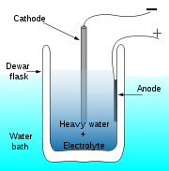
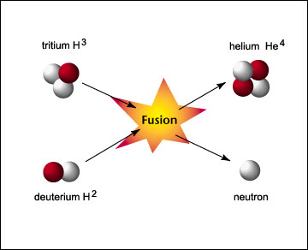
Fusion vs Cold Fusion
Fusion
Occurs at 10,000,000 Fahrenheit
Very expensive. High energy.
Cold Fusion
Occurs at room temperature.
Very cheap. Low energy

Slide 4
Cold Fusion process
Heavy water and PdCl₂
Heavy water: H₂O with Deuterium.
Deuterium: Hydrogen with a neutron
Cathode and Anode for current
Mysterious Deuterium/Neutron products.
Mysterious Energy Produced
Law of Conservation of Energy??

Slide 5
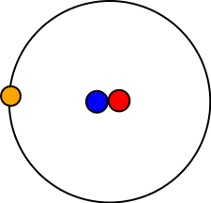
What actually happens?
2 Deuterium fuse to form helium and 24 MeV
D + D → ⁴He + 24 MeV
D is Deuterium, or ²H

Slide 6
How much is 24 MeV?
1MeV = 1.602 x 10⁻¹³ J
1.602 x 10⁻¹³ J = 1.602 x 10⁻¹³ W
So the reaction nets:
3.8448 x 10⁻¹² W
So it takes 26,000,000,000,000 reactions to power a 100 watt bulb.
This takes 52,000,000,000,000 deuterium molecules.

Slide 7
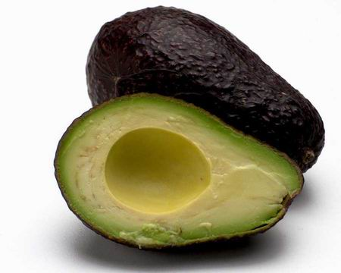
Even More Math ☺
52,000,000,000,000 D
1 Mole = 6.02 x 10²³ Molecules
8.64 x 10⁻¹¹ Moles of D are needed to power 100 watts, or 1 Light Bulb.
That’s a lot of energy for a little reaction.

Slide 8
Maybe Not.
This occurred once March 23,1989
Experiment has never been repeated
Fleischmann and Pons data may be wrong
Found many sources of error in data
Found that they had screwed up.
Fail.

Slide 9
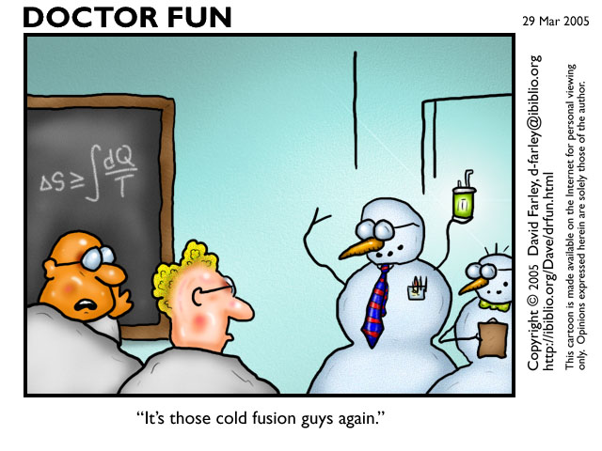
Cold fusion becomes frowned upon…

Slide 10
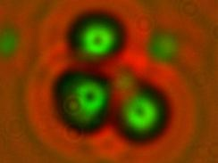
But wait!
March 23, 2009
Did the same electrolytic reaction.
Used CR-39 to detect particles
Found the above tracks in the plastic.
Shows signs of Neutrons.
http://www.sciencedaily.com/releases/2009/03/090323110450.htm
CR-39?
CH2=CH-CH2-O-CO-O-CH2CH2-O-CH2CH2-O-CO-O-CH2-CH=CH2

Slide 11
So?
If neutrons are floating around, nucleuses have to be breaking apart.
That means nuclear reactions are going on
That means we have a save and almost unlimited energy source!

Slide 12
Energy:
Having an unlimited source is very economic.
Our country would become the energy superpower.
Definitely help our economic situation.
Not polluting/bad/green house/

Slide 13
Funding?
Very insufficient funds to really push forward the research.
Nobody wants to invest when the researchers are liars.
Unlikely to receive more funding until they show more improvement.

Slide 14

Have a beary nice day.
Thank you beary much.

Slide 15
Sources:
http://www.sciencedaily.com/releases/2009/03/090323110450.htm
http://en.wikipedia.org/wiki/Cold_Fusion
http://www.google.com/hostednews/afp/article/ALeqM5j2QobOQnlULUZ7oalSRUVjnlHjng
http://www.heise.de/tp/r4/artikel/18/18580/1.html
http://jlnlabs.online.fr/cfr/html/cfr10.htm
http://www.science.uwaterloo.ca/~cchieh/cact/nuctek/energyconvert.html
Interview with Kaveh Shakeri.

